Slide 1
Smart Shopping
Team 11:
Cameron L’Ecuyer – Class ID: 17 (Team Leader)
Sneha Mishra – Class ID: 21
Navya Pillala – Class ID: 26
Ruthvic Punyamurtula – Class ID: 30
The work has been completed under the guidance of Dr. Yugi Lee and TAs
(Rohith Nagulapati, Sidrah Junaid, Nageswara Nandigam) in
CS5551 Advanced Software Engineering,
University of Missouri - Kansas City, Spring 2018

Slide 2
Project’s purpose
Develop an application that can assist a user when they are shopping for furniture online
Our app can assist our users by allowing them to use pictures to find similar items using image recognition software, and then allow them to search using online APIs to find products they may like, and view furniture in augemented reality

Slide 3
Technologies used
Android Studio for developing the Android application
Unity 3D for developing the Augmented Reality part of the application
Google Cloud Vision for image recognition
Indix Product Search API for searching for products online
BMI API for use with suggestions
MongoDB for Tweet data storage
Twitter API for retrieving Tweet data

Slide 4
Login and Register
New Users can register to the App.
Existing User can login using registered email ID.
Optional login option to the user using Twitter Credentials.
Firebase is used for Authentication as well as storage.

Slide 5
Image Recognition
The User has the following options:
Click Image using Camera
Import existing image from the gallery
Skip the Image Analysis
Analyze the uploaded image
Shop for the product using the Image analysis
Google Vision is used to analyze the uploaded image.

Slide 6
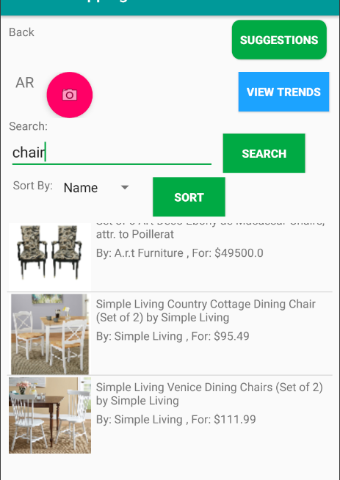
Shopping
Powered by Indix Product Search API
Indix API allows for searching of a variety of different products
Draw back: limited data that is available, such as limited number of images
Data is retrieved from Indix API using Google Network Framework – Volley
Flexible searching
Sorting is done in code

Slide 7

Suggestions

Slide 8
Trends

Slide 9
Augmented Reality

Slide 10
Thank You
The Demo video is available here -
https://www.youtube.com/watch?v=wyObDwxgtMU&t=1s

